Slide 1

AUDIO AURA
CS 661 Project
Under the guidance of Prof. Soumya Dutta
Presented by: Group 1
Akash Varude
Darshan Jain
Deepen Shrestha
Indraneel Rajeevan
Nitish Kumar
Pankaj Nandeshwar
Pranjal Nandeshwar
Shaurya Agarwal

Slide 2
Introduction
In the dynamic realm of music, knowing what resonates with audiences is crucial. Our data-driven exploration helps us uncover trends and insights driving musical achievements. With innovative analytics and visualization, we navigate through genre preferences, artist popularity, musical scales, and emerging trends.
Join us as we decode the secrets of musical success, shaping the future of music creation and engagement.
Project Repository:
https://github.com/deepen-stha/CS661-Big-Data-Visual-Analytics
Web Application:
https://cs661-big-data-visual-analytics-group1.streamlit.app/

Slide 3
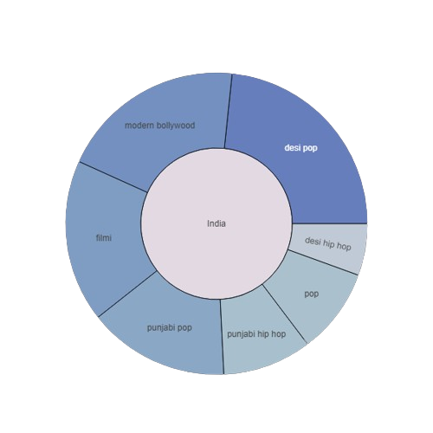
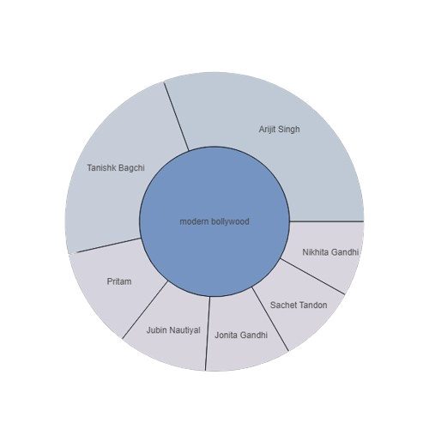
Selection of the ideal Genre and Artist
For a given region, the plots show
The top ‘m’ genres in that region
The top ‘k’ artists for the given genre
Total streams for the given genre/artists (Hover based)

Slide 4
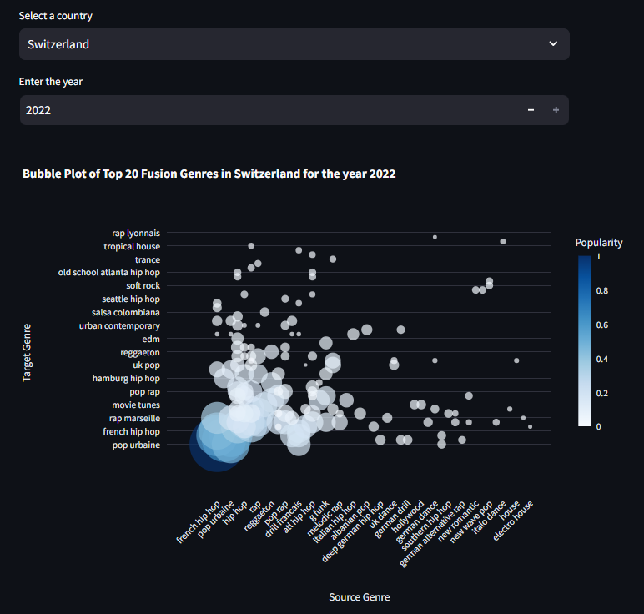
Genre Fusion
The bubble plot captures the following insights:
Genre fusion popularity by country and year
Assists label companies in tracking current trends
Reflects global interest in genre fusion

Slide 5
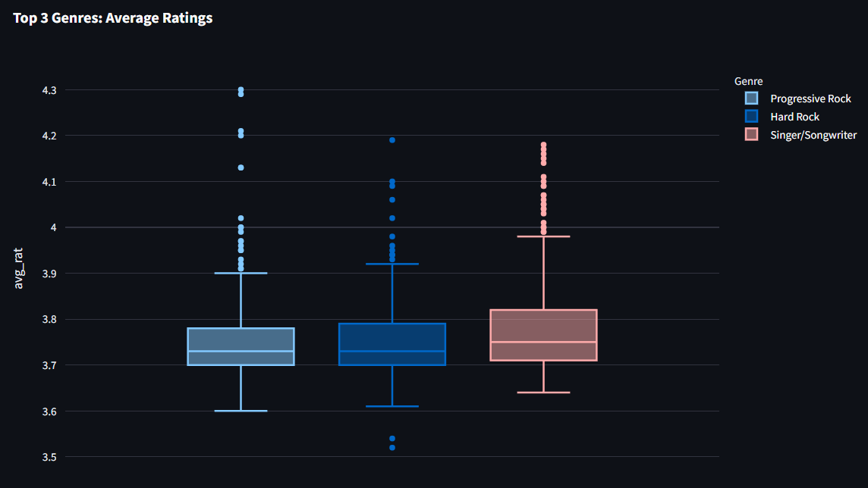
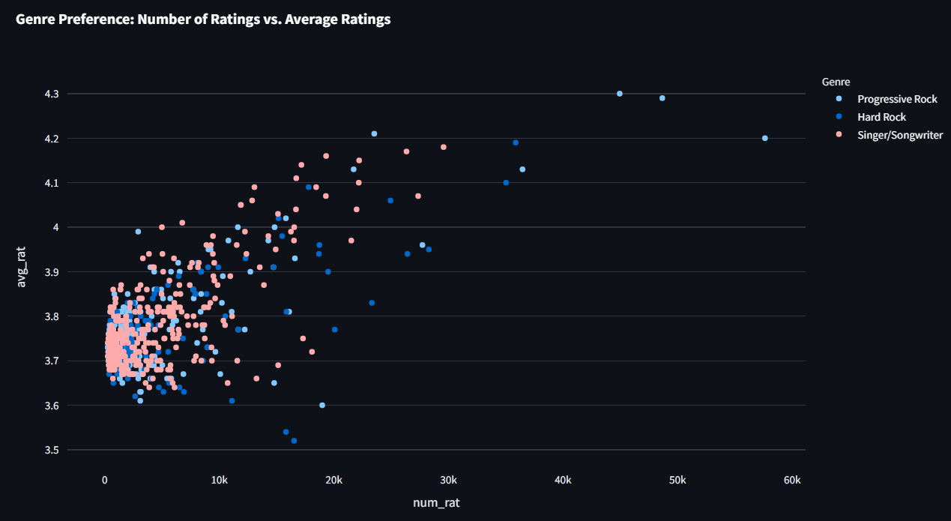
Genre wise analysis of Top 5000 albums
Average Ratings: To know what genres are contributing more in top albums
Box plot to visualize summary stats
Number of ratings: To know effectiveness of ratings
Each point represents album name
Color represents genre of the album

Slide 6
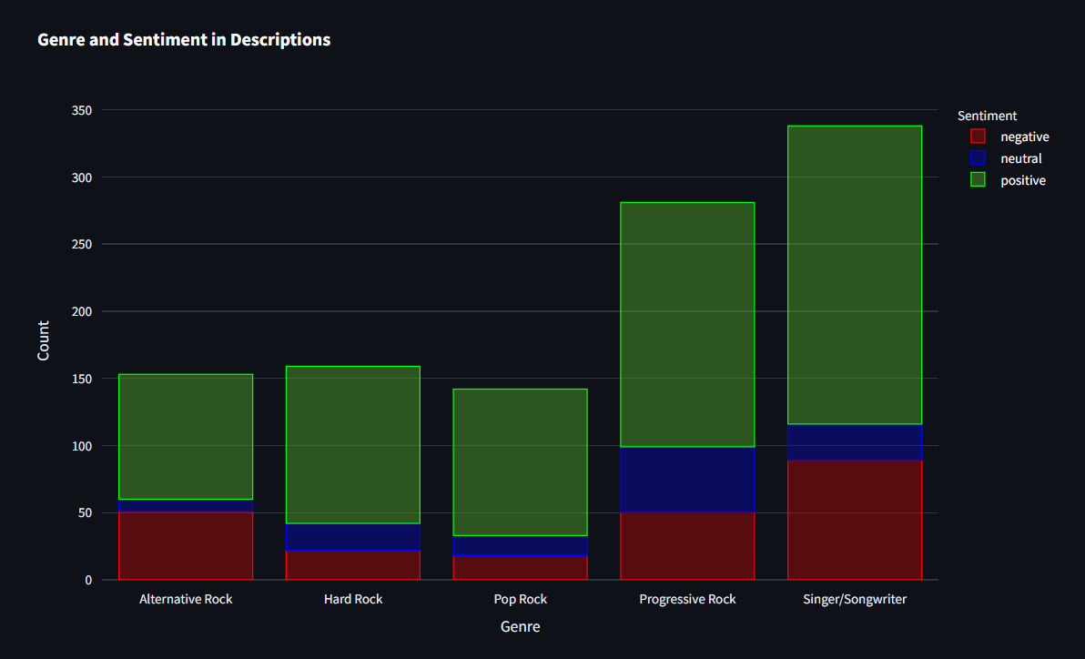
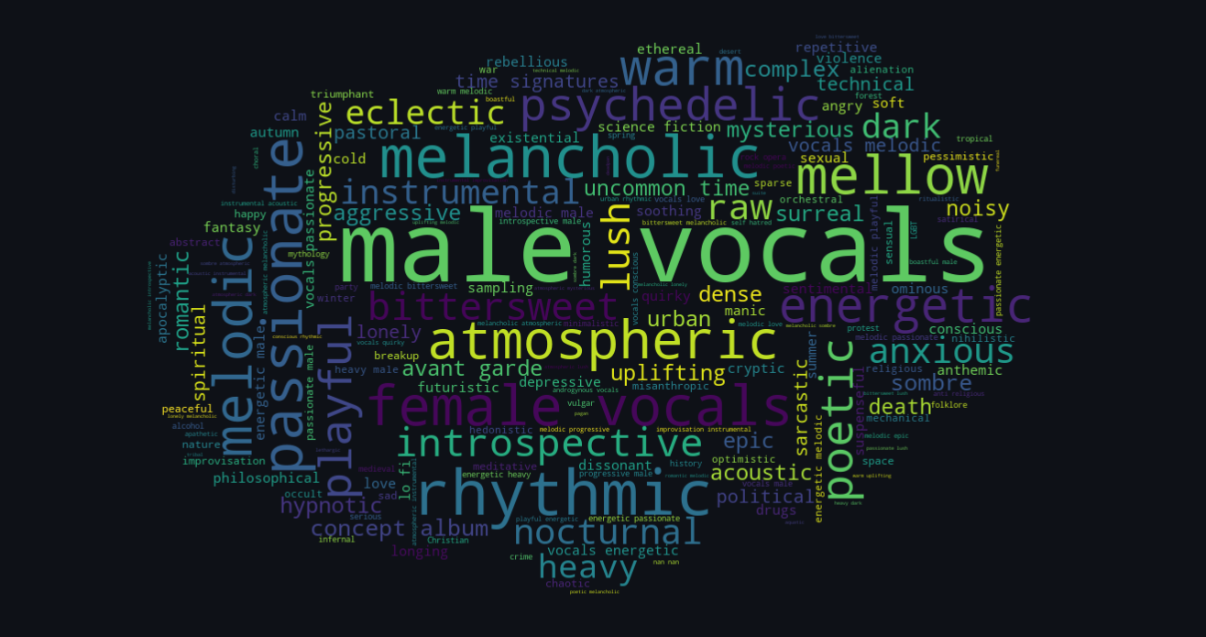
Genre wise analysis of Top 5000 albums
Genre wise sentiment analysis of albums descriptions
To analyse the type of content present in the albums
Word cloud: To get insight of the comparison of frequencies of word used for sentiment analysis.
Functionality added in plots:
User can view for top 3 to top 15 genres
Select single or multiple genres for analysis

Slide 7
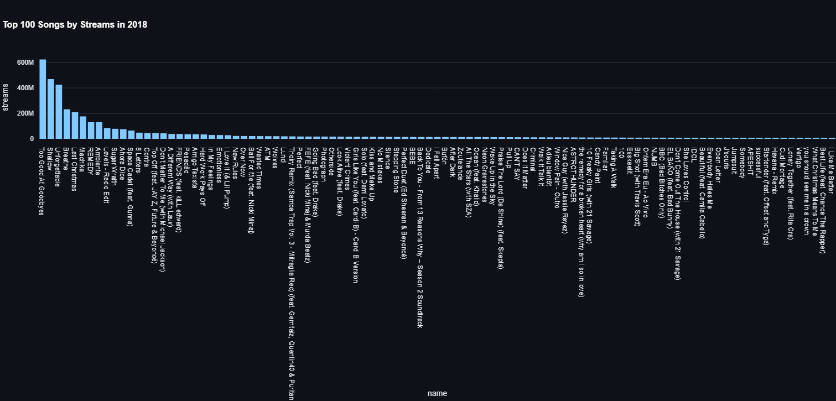
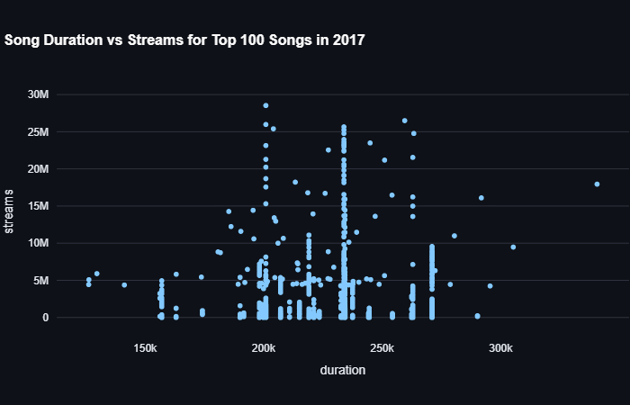
Top 100 Songs Annually (2013-2023)
Provides insight into the most popular songs annually.
Reflects trends and preferences in music consumption over the years.
Indicates which artists have a larger share of the streaming market.
Offers insights into listener preferences for explicit content.
Highlights trends in song length and potential shifts in audience preferences.

Slide 8
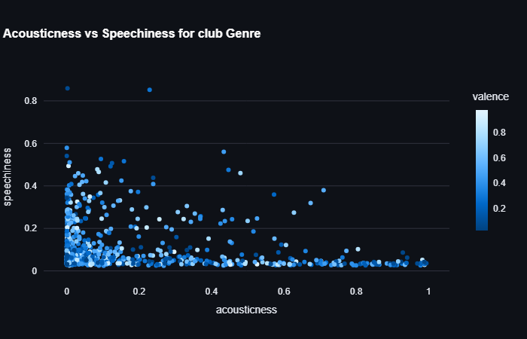
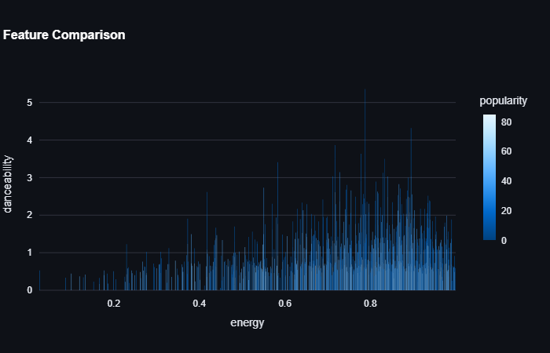
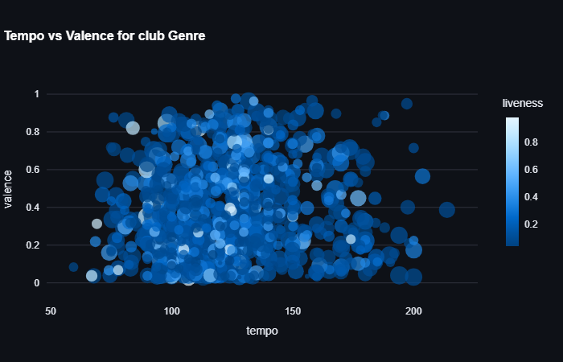
All time Top-5000 Songs by Genre
Provides insight of the Top-5000 songs of all time by Genre.
Acousticness Vs Speechiness:
Helps identify trends in song production style, such as acoustic instrumentation versus electronic elements and speech-like characteristics.
Feature Comparison:
Exploration of how different song features interact and contribute to a song's popularity within the genre.
Tempo Vs Valence
Insights on correlation between tempo, valence, and the popularity of songs.

Slide 9
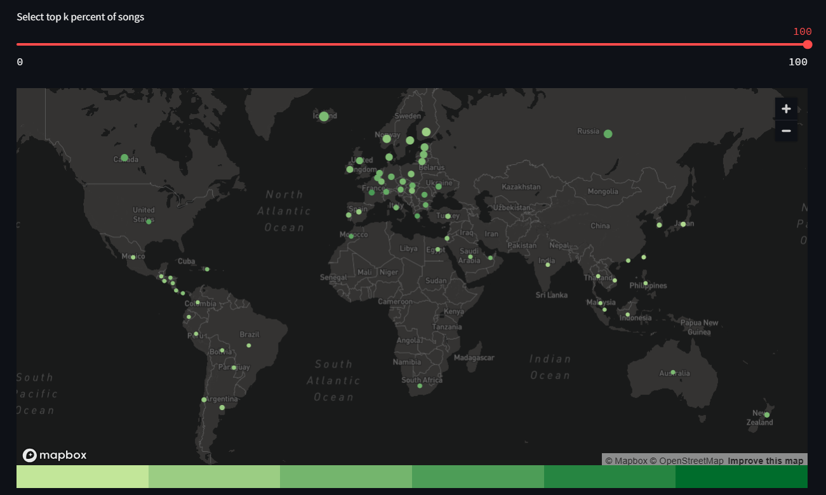
Region Wise explicit content:
This map shows the trend for “explicitness”
For the last few years trend has been increasing for explicitness in songs, but not in every region
This map depicts the percentage of songs that have explicit content over the countries (67 countries)
With a variable of taking the top - k% songs with most streams.

Slide 10
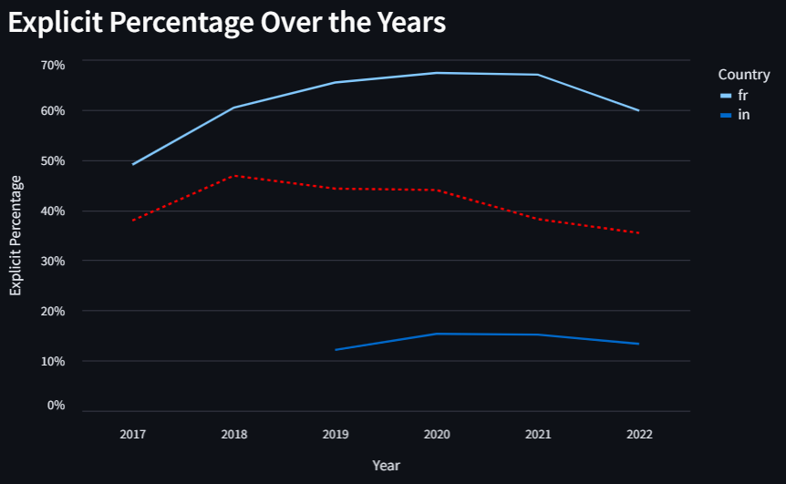
Explicit content over time period:
This map shows the trend for “explicitly” for time being
The reference of global trend is given with red dotted line
The other lines are for a country over the years
This also shows the growth over the years
Global value is around 42%

Slide 11
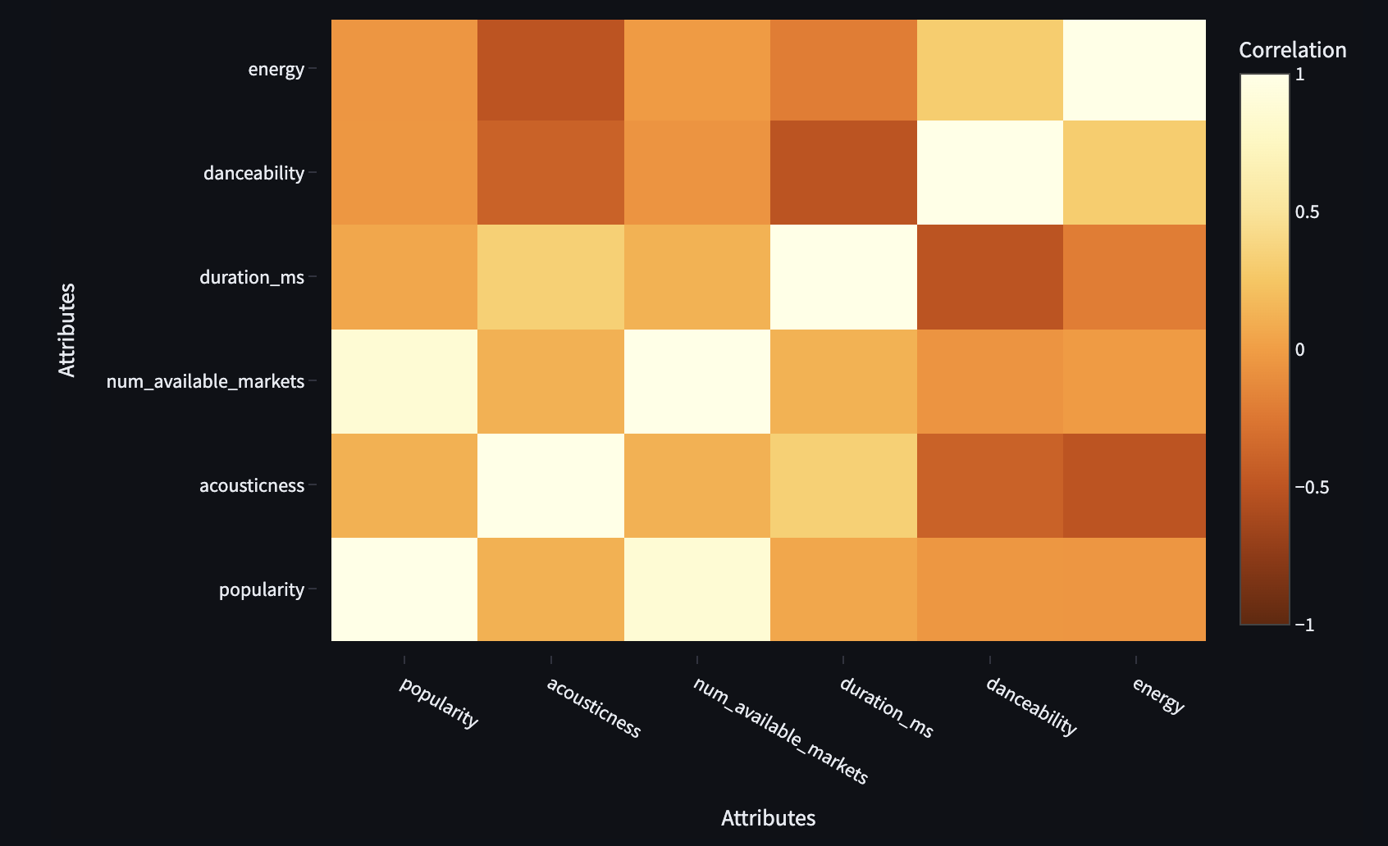

Insights via Inter-relation of Songs’ Properties:
In Popular Songs:
Acoustic songs tend to be longer in duration as compared to songs with danceability
This trend is followed by most of the countries and is logical.

Slide 12
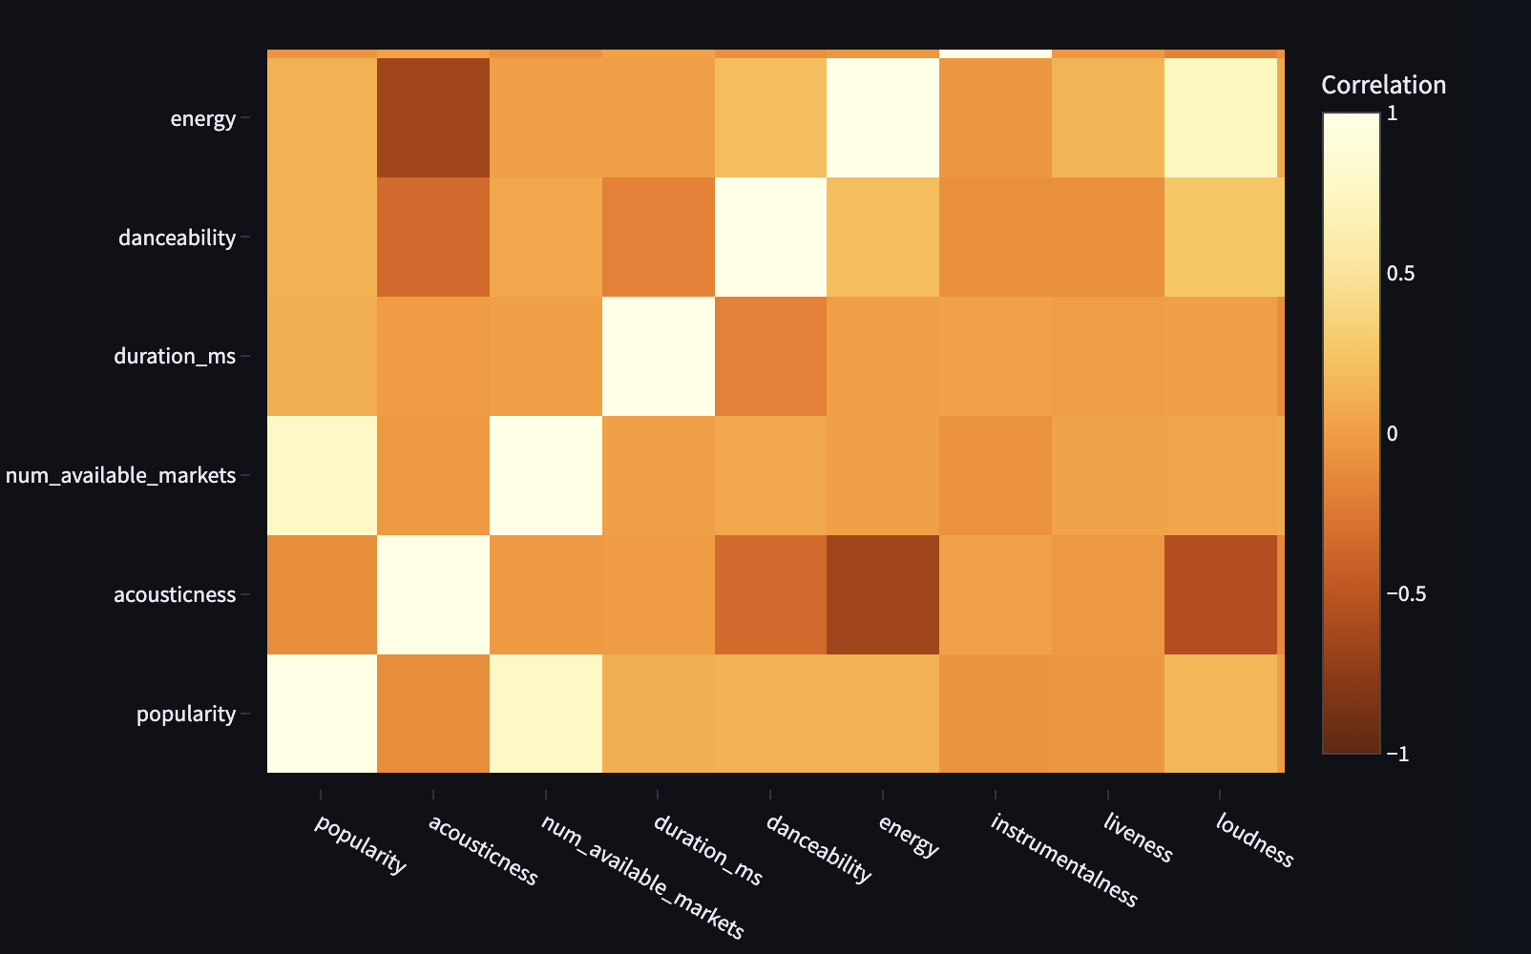
Songs with more acousticness tend to have little to no energy, loudness, and danceability and vice versa
This is a very strong trend followed in most of the countries

Slide 13
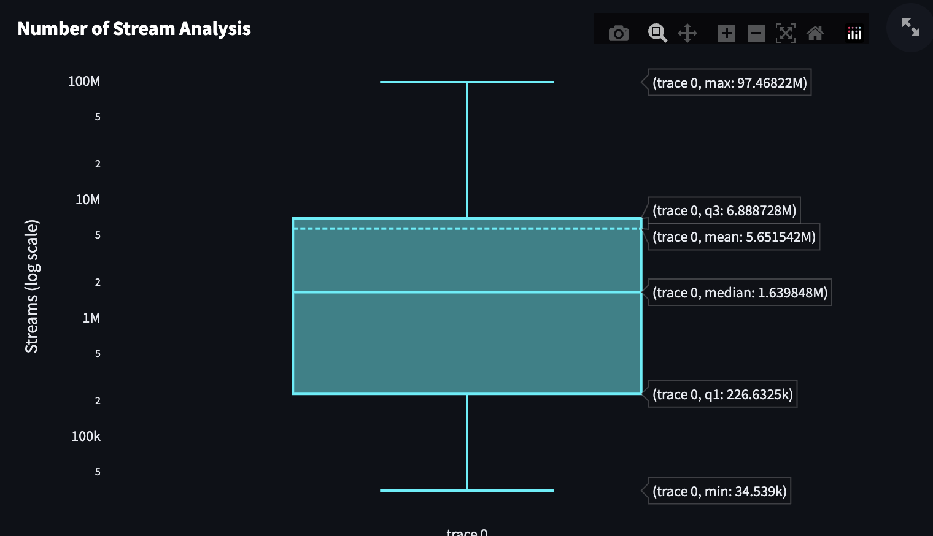
Similarly, songs with more danceability tend to had more loudness and valence.
Songs which are not popular were not launched in many countries
(That makes sense, Why?)
#Stream analysis:
We got the idea of median and mean #streams based on countries
This will help music production companies to decide in which countries they should launch their music

Slide 14
Bolivia Case Study:
In 2019:
Songs with more energy and loudness had no or very less instrumentalness
Trend showed that audience didn’t like those songs,
As a result, those songs flopped in the market
It was observed that people preferred loud and energetic songs with some instrumentalness
Music Industry of Bolivia learned from this and, then balanced those in the upcoming years
As a result, they got better results, more streams than previous years

Slide 15
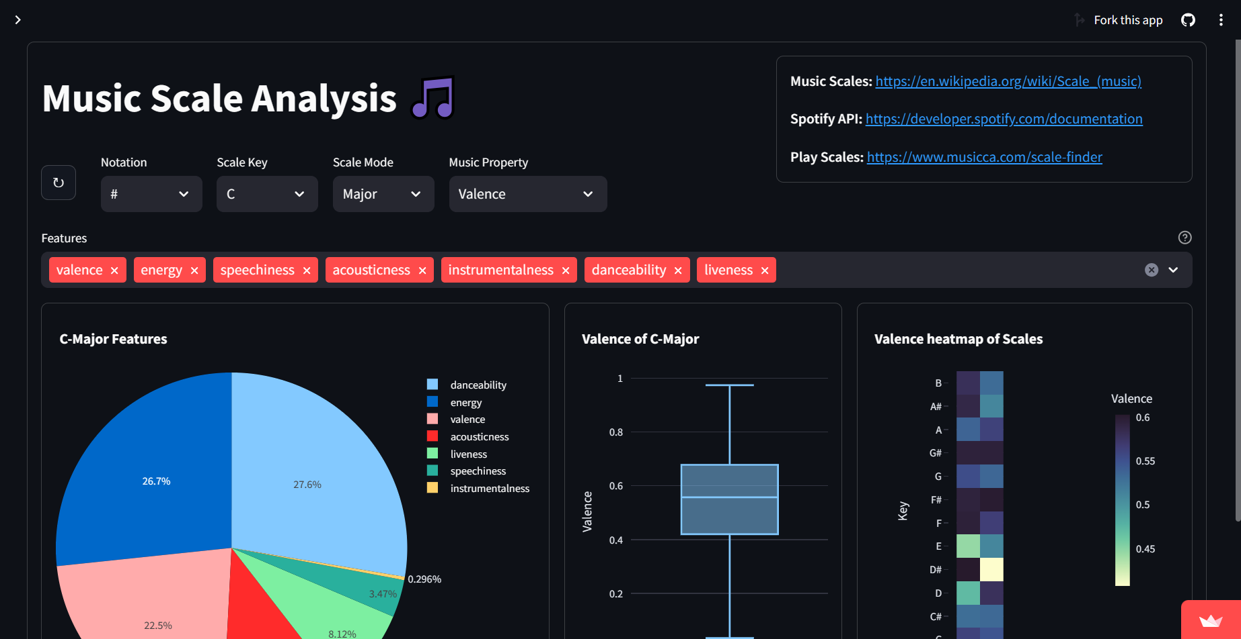
Music Scale Analysis
Visualize the relationships between a chosen Song Property and all the Music Scales
Visualize the relationship between a chosen Song Property and a chosen Music Scale
Visualize the relationships between a chosen Music Scale and any subset of the Music Properties
Customize the Music Notation

Slide 16
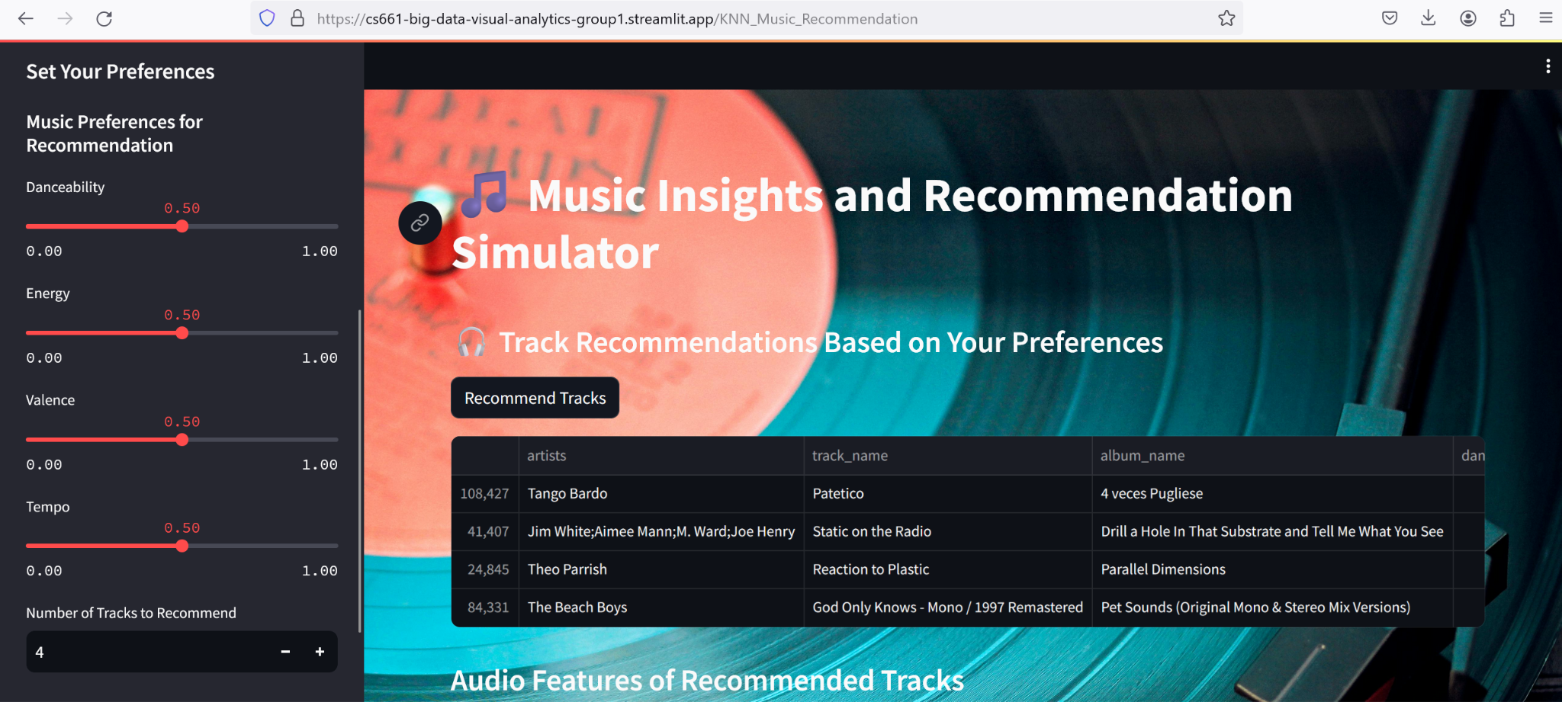
KNN Music Recommendation
Recommending songs from our data to customers on the basis of Danceability, Energy, Valence, Tempo.
Minimum recommendation user can select is 2 and maximum it can go to 6. Default value will be 5.
The final predicted value is then plotted using matrix of scatter plot and histogram (pairplot or scatterplot matrix).

Slide 17
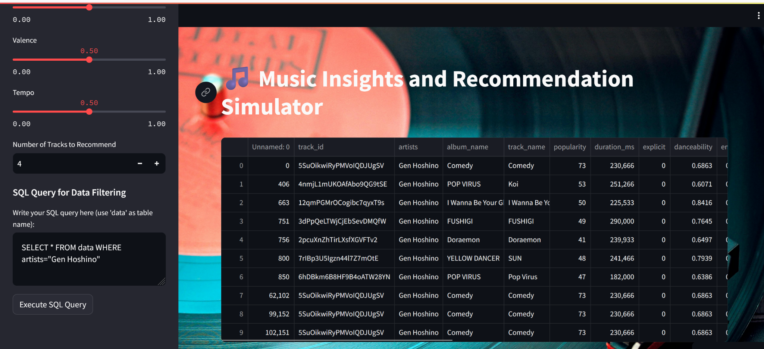
SQL Querying
Feature to query our big structured data is also provided in the interface.
This will helps user to query and find songs they like.
The user can perform query on the basis of artist, album_name, track_name, popularity, track_genre and many others fields.
This is implemented using pandasql.
It doesn’t allow other subset of SQL other than DQL.

Slide 18
Conclusion
Our project on Music Data Visualization and Analysis offers valuable insights and solutions for the modern music industry.
Our project is an integration of advanced data analytics, interactive visualizations, and efficient data processing strategies to empower music producers.
Identification of top genres/artists, albums, desirable properties in songs, optimal musical scales, and actionable insights into audience preferences have been the notable outcomes.
Optimization and handling of large datasets has been done for seamless visualization.

Slide 19
An endeavor to merge sound and sight, creating a symphony for the eyes
Thanks

